Slide 1
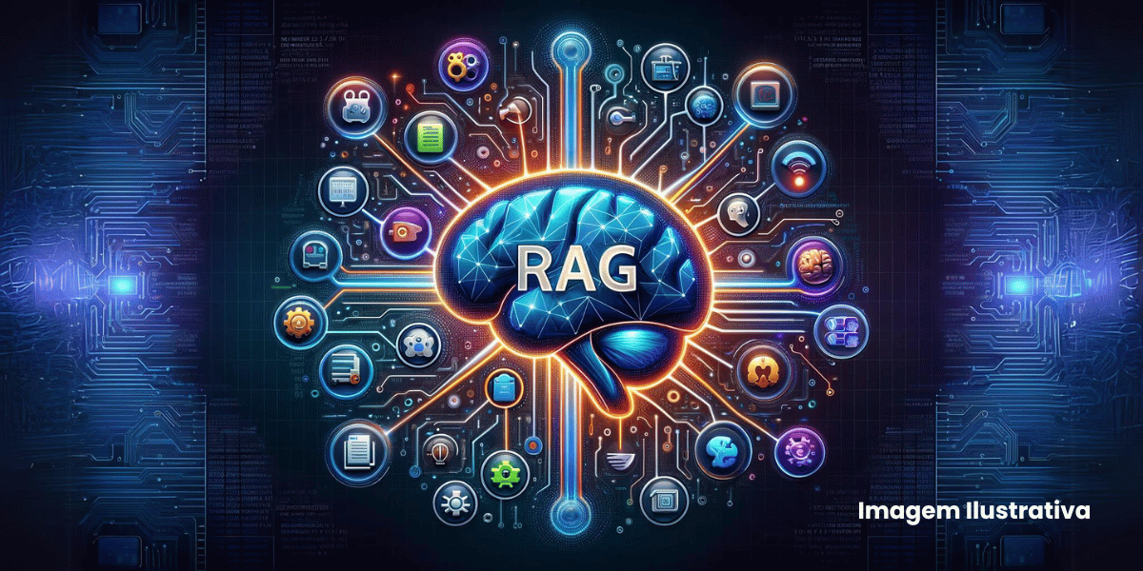
Agentic Domain-Specific RAG System
Narrative, Thematic & Character Analysis of Curated Film Documents
Developed Using:
Databricks • LangChain • ChromaDB • OpenAI • MLflow
                Presented By:
                Goutham Raju Purushotham
                Ulviyya Rahimova
                Course: NLP
                Date: April 13, 2026

Slide 2
Project Setup & Initialization
Purpose
Establishes the foundation of the RAG system
Defines configuration before ingestion, retrieval, or generation
Core Configuration
Embedding Model: text-embedding-3-large
LLM Model: GPT-4o
Chunk Size: 1200
Overlap: 200
Top-K Retrieval: 5

Slide 3
Document Ingestion & Data Structuring
Objective
Input layer for chunking and embedding
Ingestion Pipeline
Load PDFs from raw_pdfs/
Extract text using PyMuPDF
Apply:
  normalization
  whitespace cleaning
  text aggregation
Metadata Generated
doc_id | file_name | source_path
raw_text | char_count | ingested_at
chunking → splits raw_text into semantic units
Output
→ documents_metadata.csv

Slide 4
Chunking & Metadata Generation
Objective
Split documents into smaller semantic chunks
Prepare data for embedding and retrieval
Chunking Process
Input: documents_metadata.csv
Split raw_text into chunks using:
  fixed chunk size
  defined overlap
Ensures:
  context preservation
  better retrieval accuracy
Chunk Metadata
  chunk_id | doc_id | file_name
  chunk_text | chunk_index
  chunk_size | chunk_overlap
  created_at
Output
→ chunks_metadata.csv

Slide 5
Chunking Strategy & Text Segmentation
Objective
Transform document-level text into retrieval-optimized semantic units
Enable high-precision vector similarity search
Processing Pipeline
Input: documents_metadata.csv
Operates on: raw_text field
Chunking Mechanism
Fixed-size segmentation using:
  CHUNK_SIZE = 1200
  CHUNK_OVERLAP = 200
Chunking enables:
  localized semantic matching
  reduced noise in retrieval results

Slide 6
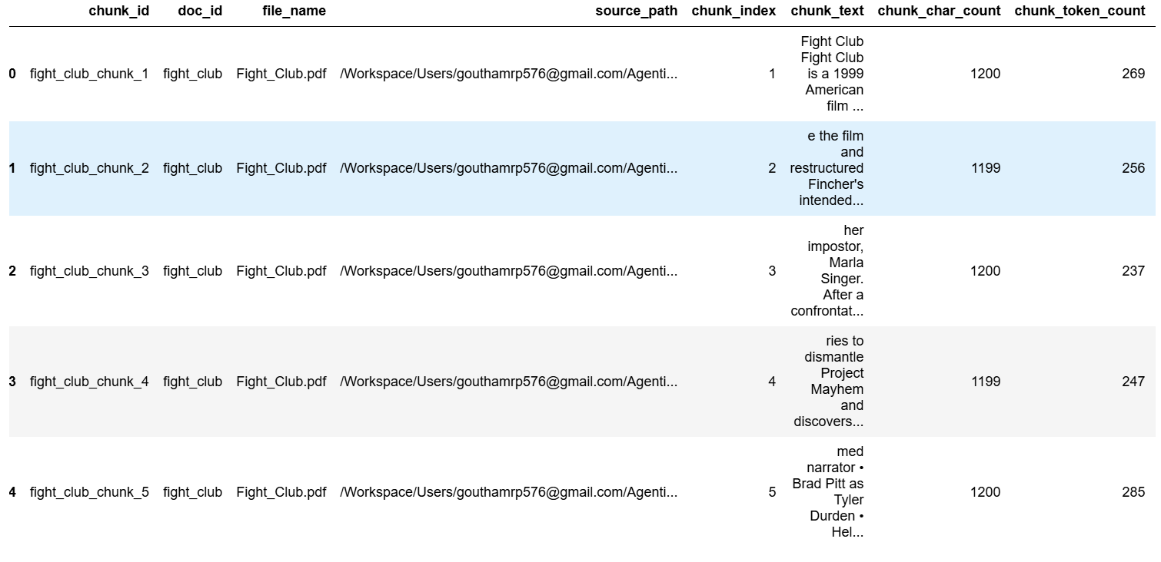
Chunk Metadata, Storage & Retrieval Readiness
Data Storage
Output stored as:
→ chunks_metadata.csv
Input: structured documents
Output: chunk-level dataset
Next Stage:
→ Embedding generation (vectorization)
→ ChromaDB indexing
Chunk-Level Data Structure

Slide 7
LangChain RAG Pipeline (Retrieval & Generation)
Objective
  Build the core RAG pipeline integrating retrieval + LLM generation
  Convert user query into context-aware, grounded response
Pipeline Flow
  User Query → processed by LangChain
  Query converted to embedding vector
  Similarity search on ChromaDB
  Retrieve Top-K relevant chunks
Context Construction
  Retrieved chunks combined into:
  structured context block
Passed along with:
  user query
  optional chat history
LLM Integration
  Model: GPT-4o

Slide 8
Prompting, Chain Logic & System Integration
LangChain Orchestration
Uses chain-based execution flow
Components:
  retriever
  prompt template
  LLM call
  output parser
Enforces:
  grounded answers
  no hallucination
Pipeline Integration
Input: chunks_metadata.csv → ChromaDB
Output: final generated answer

Slide 9
LangChain RAG Pipeline (Retrieval + Generation Layer)
Pipeline Execution Flow
  User query → converted into embedding vector
  Perform similarity search (Top-K = 5) on ChromaDB
  Retrieve most relevant document chunks
  Construct context block from retrieved chunks
LangChain Orchestration
Components:
  embedding model (text-embedding-3-large)
  retriever (ChromaDB)
  prompt template
  LLM chain

Slide 10
Agentic RAG with Tool Calling (Decision Layer)
Objective
Extend RAG into an agentic system with dynamic decision-making
Enable model to choose between internal retrieval and external tools
Decision Mechanism
LLM evaluates:
  user query intent
  sufficiency of retrieved context
Outputs structured action:
  INTERNAL_ONLY
  GOOGLE_SEARCH
  YOUTUBE_SEARCH
  GOOGLE_AND_YOUTUBE
Tool Integration
Google Search → SerpAPI
YouTube Search → YouTube API
Results injected into final prompt context
Execution Flow
Query → Retrieval → Decision → Tool Call (if needed) → Context Update → Final LLM Response

Slide 11
Conversational Memory & Session Management
Memory Storage
Stored in session_logs.csv
Tracks:
  session_id
  user query
  response
Execution Flow
Retrieve past history using session_id
Inject into LLM prompt with current query
Impact
Improves context awareness
Supports follow-up questions
System Role
Transforms RAG into a context-aware conversational system

Slide 12
MLflow Tracking & Observability Layer
Objective
Enable end-to-end tracking of RAG pipeline execution
Provide transparency and evaluation capability
Tracked Components
Parameters:
  user query
  decision action
Metrics:
  latency
  number of retrieved sources
Artifacts:
  full response (JSON)
Integration
Implemented within Databricks MLflow
Each query recorded as a separate run

Slide 13
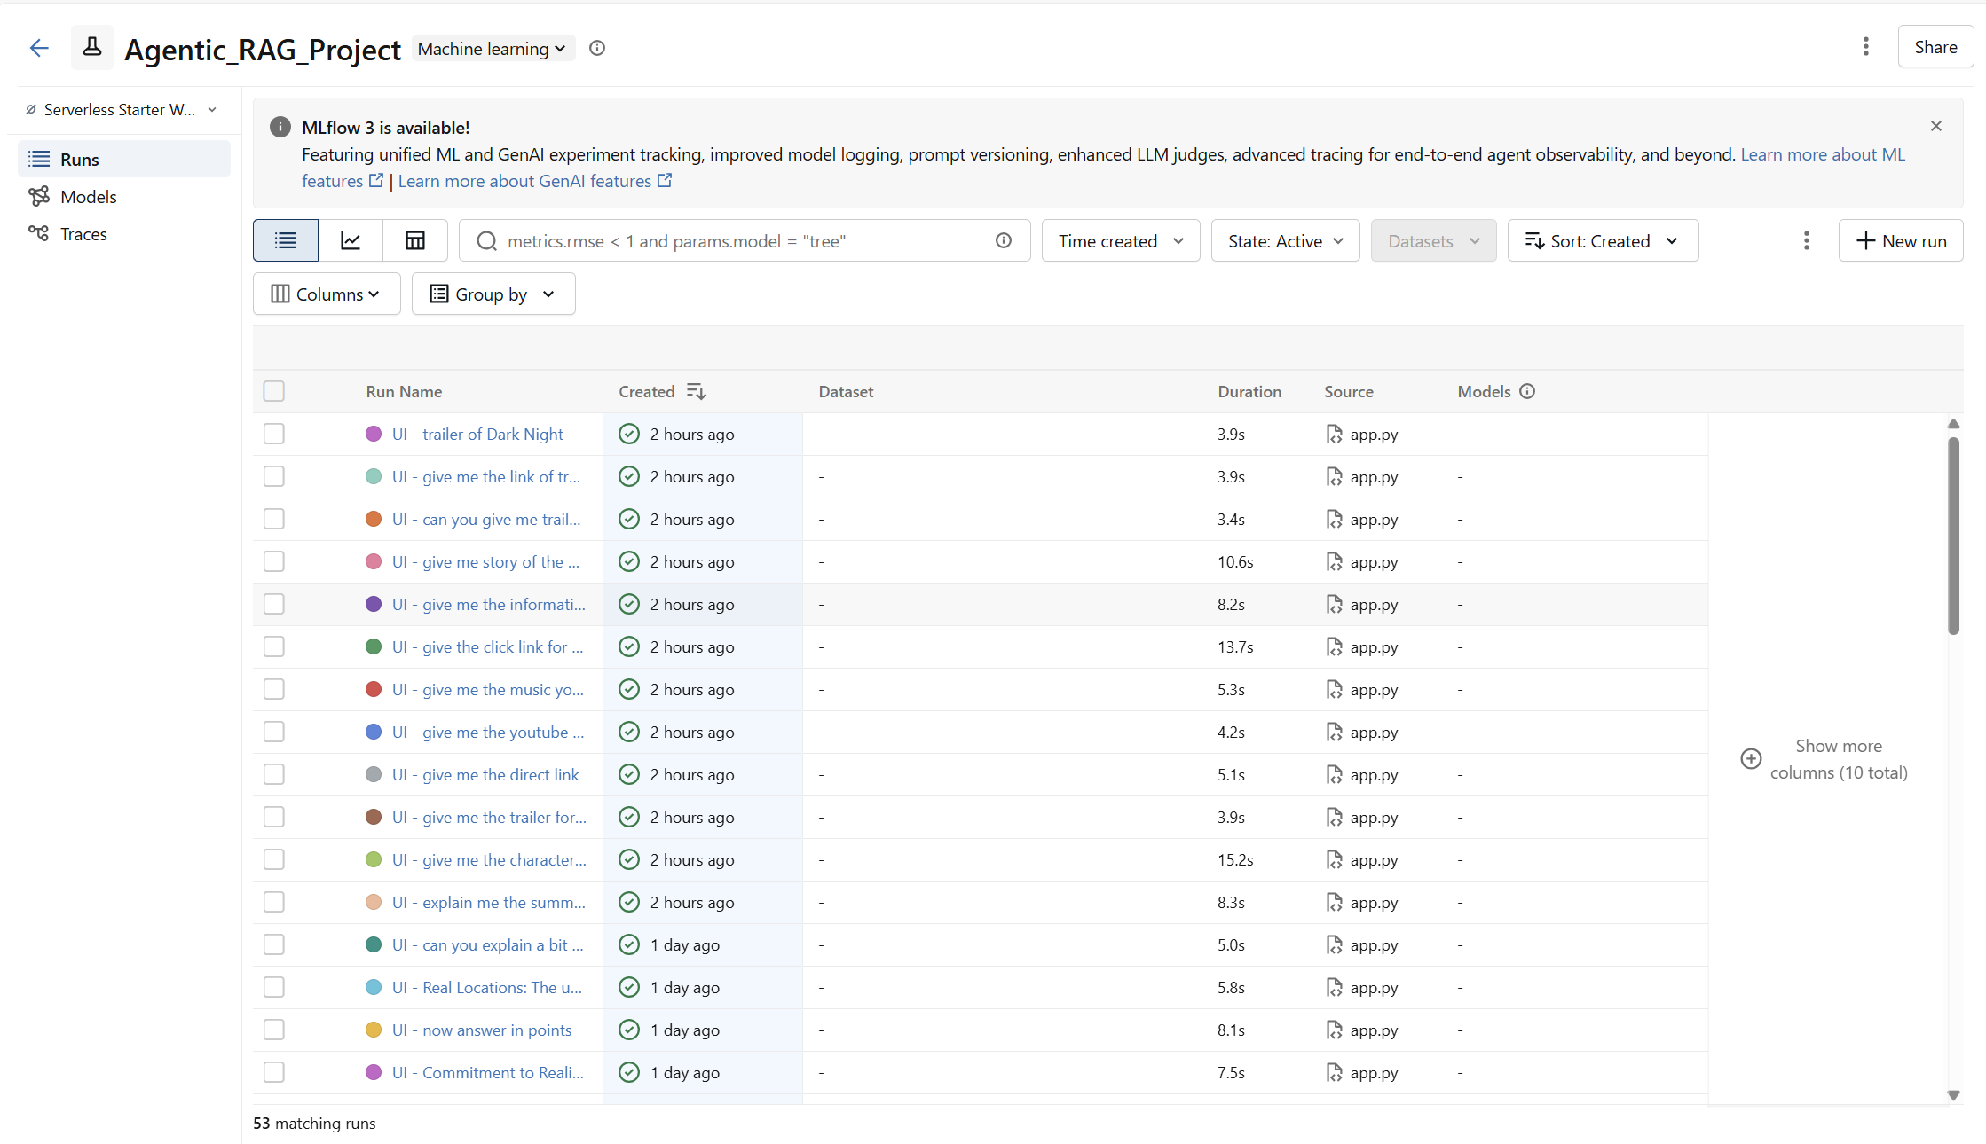
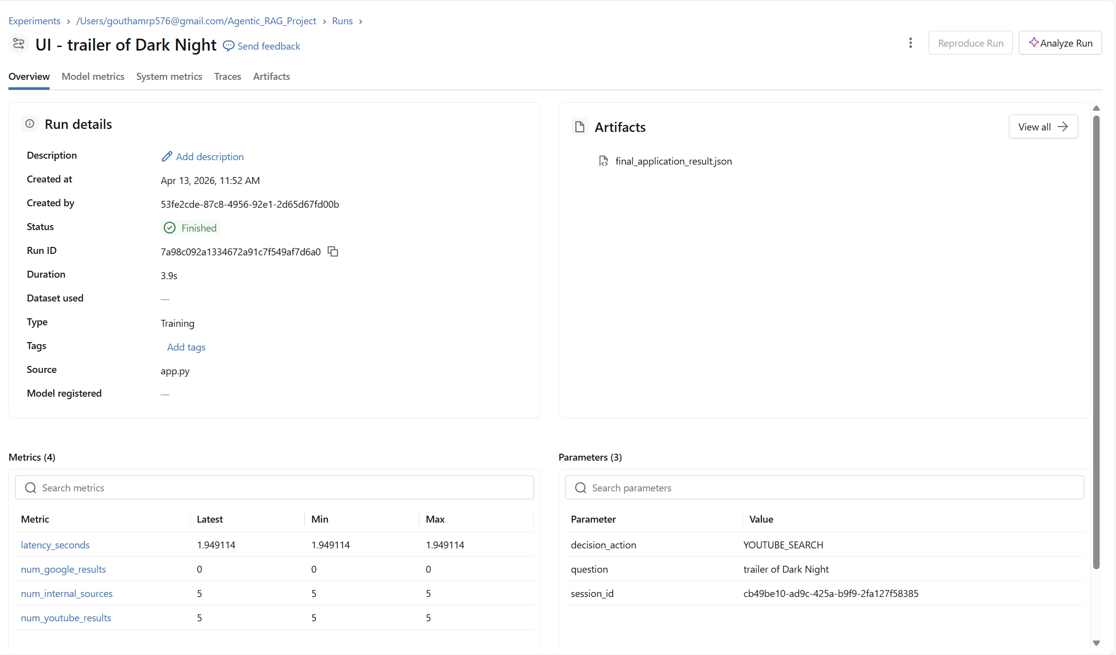
MLflow Tracking

Slide 14
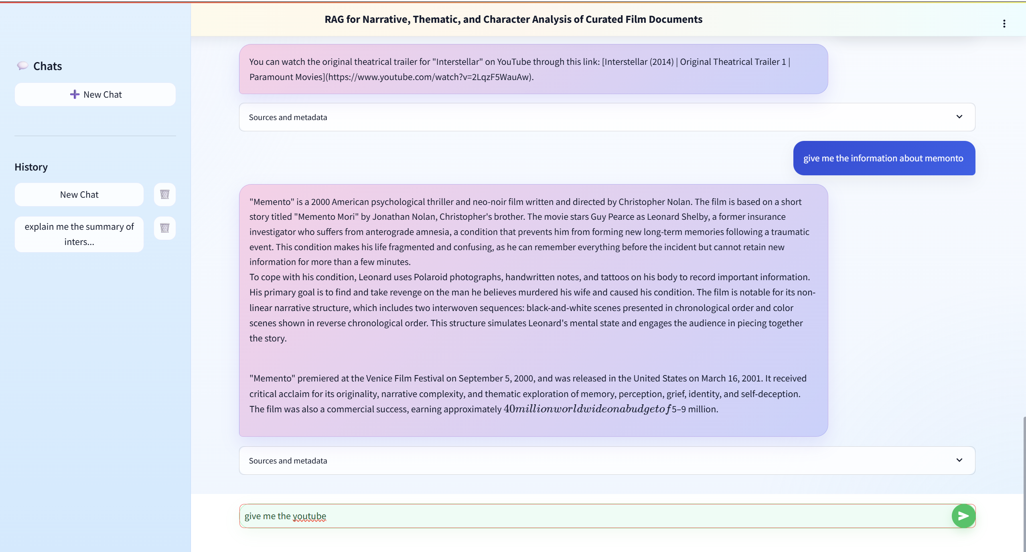
Prompting ui

